Slide 1

Implementation of Secure Fingerprint based Voting System using Arduino
Mini Project Work (19EC6DCMPR)
Phase 2 Presentation
April 2022, 6th Semester
Dayananda Sagar College of Engineering, Bangalore, Karnataka
Department of Electronics & Communication Engineering
Section Co-Ordinator:
Prof. Shobha A.S.
Mini Project Batch No : D7
Mini Project Guide:
Prof. Manasa R.K.
1DS19EC714
1DS19EC715
1DS19EC721
1DS19EC725
Dhananjay Natani
Ekta Sinha
Krati Sharma
Narayan Kumar

Slide 2
Overview
Introduction
Problem Statement & Objectives
Literature Review
Methodology adopted with Block-Diagrams & Flow- Charts
Hardware and Software tools used
Results
Applications, Advantages, Outcome and Limitations
Conclusion and Future Work
Reflections
References

Slide 3

Introduction
Elections are a defining feature of a democratic government.
The fingerprint based voting system is an electronic voting machine using biometric information. It is more efficient and quicker than paper ballot voting system, and it is more secure than ordinary EVMs.
The use of a fingerprint based verification step solves the problem of vote rigging as only the fingerprint of an eligible voter will activate the device.

Slide 4
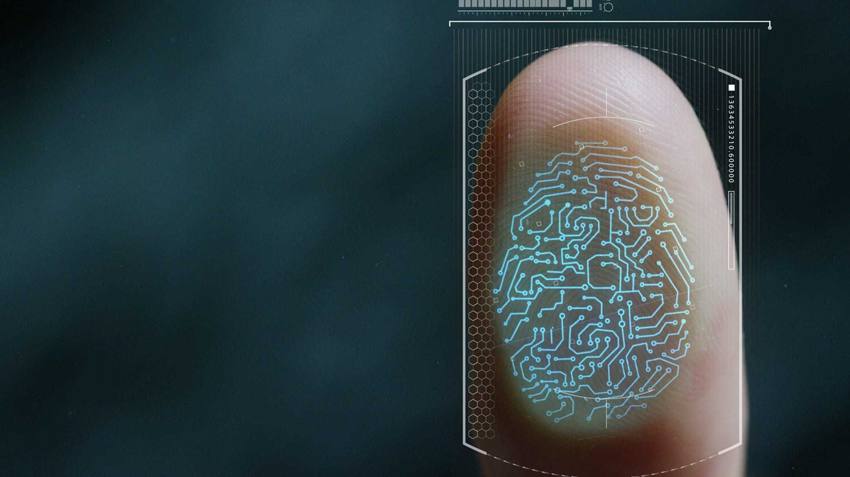
Introduction
It can prevent a voter from voting multiple times as attendance information for voters can be stored. Thus, this project aims at developing a model of one such system which intends to make the election process transparent, simpler, reliable, quicker and secure.
The project employs the concept of two step verification which ensures that our votes are cast to person of our choice.
We use biometrics for this very important responsibility. Once verified it employs with second step, that is it sends OTP to the registered mobile number of the user and only when the user enters the correct OTP the user is allowed to vote and is registered.

Slide 5
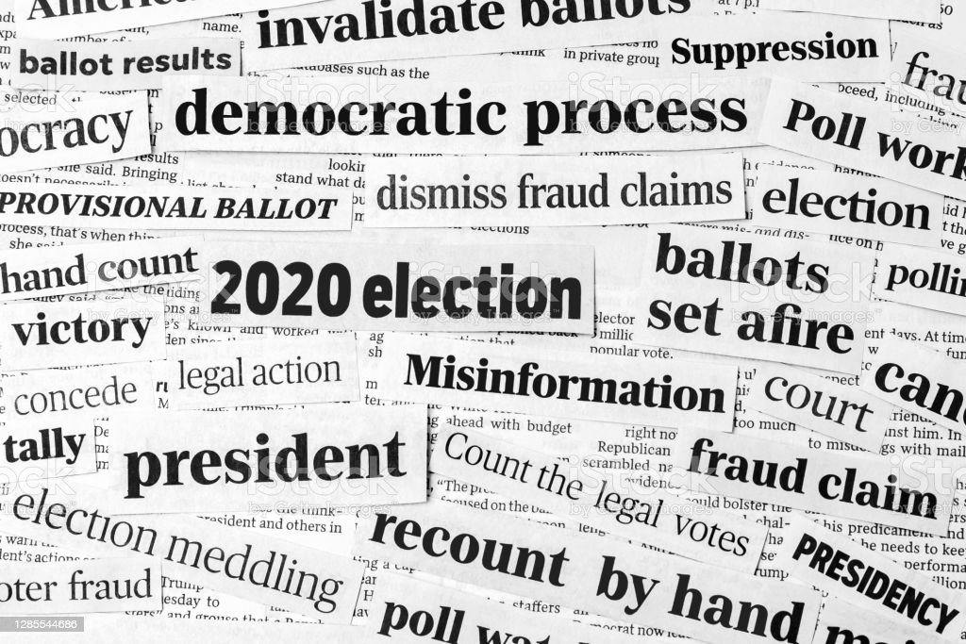
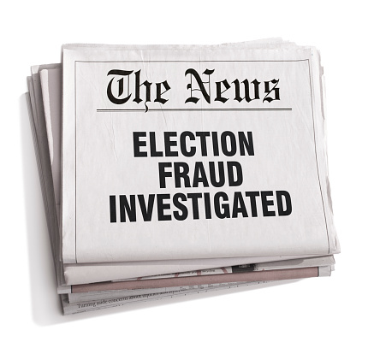
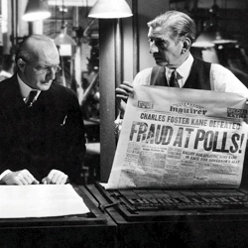
Problem Statement
There are a lot of problems present in the current election and voting environment regarding security, integrity, fraudulent voting, vote rigging, duplication of votes etc.
The security problems occur as many a times people casting votes may not have a valid id or may use another person's id to cast a vote in favor of the party they support.
In many cases it has been observed that people cast votes impersonating dead people using their voter ID's, this raises a major issue of illegal voting and also compromises with the integrity of the complete voting system.

Slide 6
Objective
This project aims to develop a model to resolve the problems present in the current voting system by implementing a “Secure Fingerprint based Voting System”.
By developing a biometric based system the project aims to resolve the problem of duplication of votes and also aims to solves security and integrity issues by ensuring that every person votes only once and no one impersonates another person's identity.
To make the system even more secure two levels of verification of every voter at the time of voting is implemented, the first level being the biometric verification verification and the second level of security being the OTP verification.

Slide 7
Literature Review
S. No. | Authors | Year | Concept of Relevant Interest
[1] | M.Venkata Rao, Venugopal Rao Ravula, Pavani Pala. | 2016 | Device : Ant rigging Voting System Using Biometrics Secure voting environment using fingerprints as biometrics.
[2] | N. Narayanan, Ch. Surya Pradeep, Piyush Gulati, G. Raj Bharath, S.Nivash | 2019 | Device : Highly Secured Biometric Voting System OTP verification for electronic voting machine.
[3] | Vakiti Mounika, Dr.S.A.Muzeer | 2016 | Device : Voting System Using Embedded Security Indication of voting status to user using GSM module.
[4] | Shubhranil Chakraborty, Dootam Roy | 2020 | Device: Design of Fingerprint Based Voting Machine Concept of EEPROM integrated in microcontrollers.

Slide 8
Methodology
Implemented using Arduino Uno, which is an open-source single-board microcontroller for building digital devices.
Programmed using the C/C++ language including some hardware libraries.
Consists of two units: an Acknowledgment Unit (AU)/Control Unit, and a Voting Machine (VM).
The fingerprint sensor is connected to the AU. The system loads the fingerprint templates, candidate numbers (per respective template), and list of candidate numbers with values initialized to zero, from on-chip EEPROM.

Slide 9
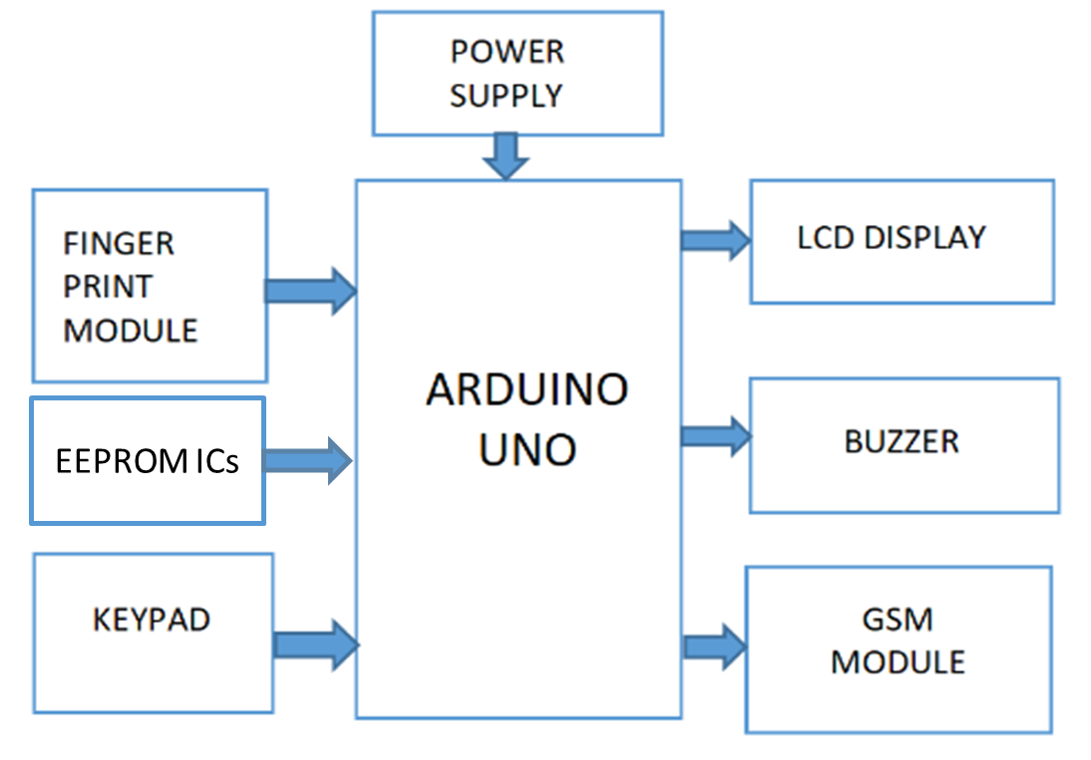
Methodology
The system verifies the fingerprint of a voter and checks whether it is valid, and if so, whether the voter has already cast a vote.
Then, the GSM sends an OTP to the registered mobile for further verification of the voter at the time of voting.
The AU activates the VM after credibility check and then the voter casts a single vote.
Then, the voter is marked as voted and the count for the particular candidate is incremented, and stored in memory.
Fig: Block Diagram of the designed system.
9

Slide 10
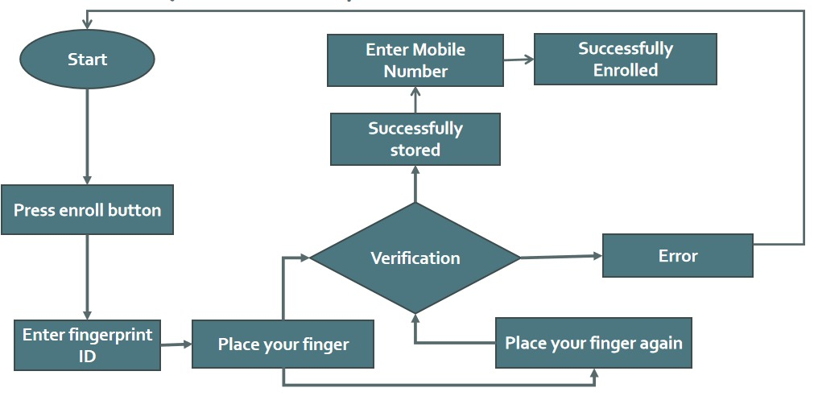
Flowchart: (Enrollment)

Slide 11
Flowchart: (System)
Start
NO
OTP Verification
NO
YES
NO
Data Verification
YES
Already Voted?
Getting Fingerprint
YES
Polling
Polling status message
From Database (on-chip EEPROM)
Exit

Slide 12
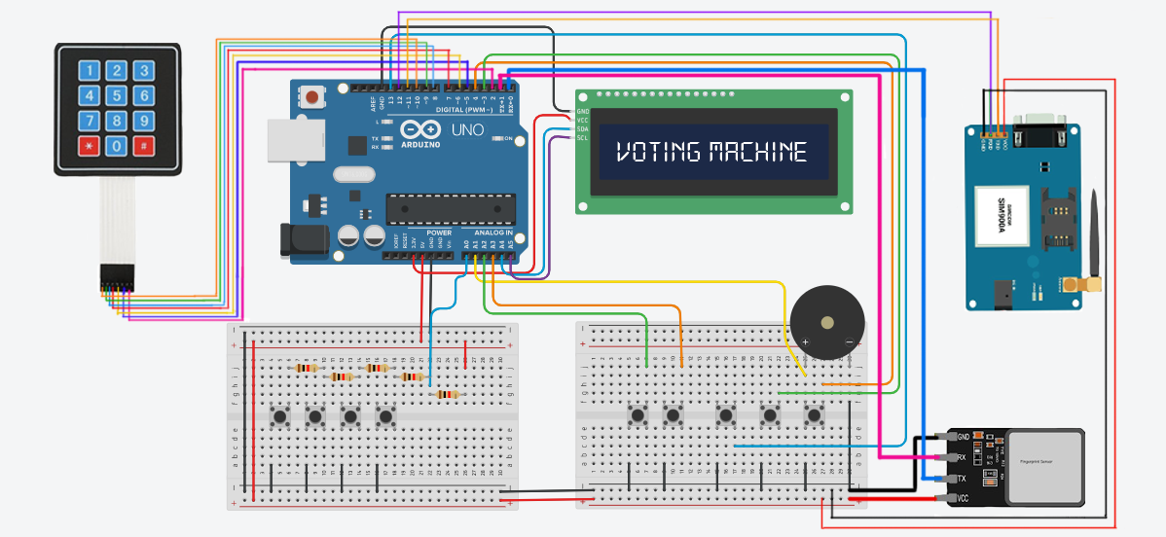
Circuit Diagram

Slide 13
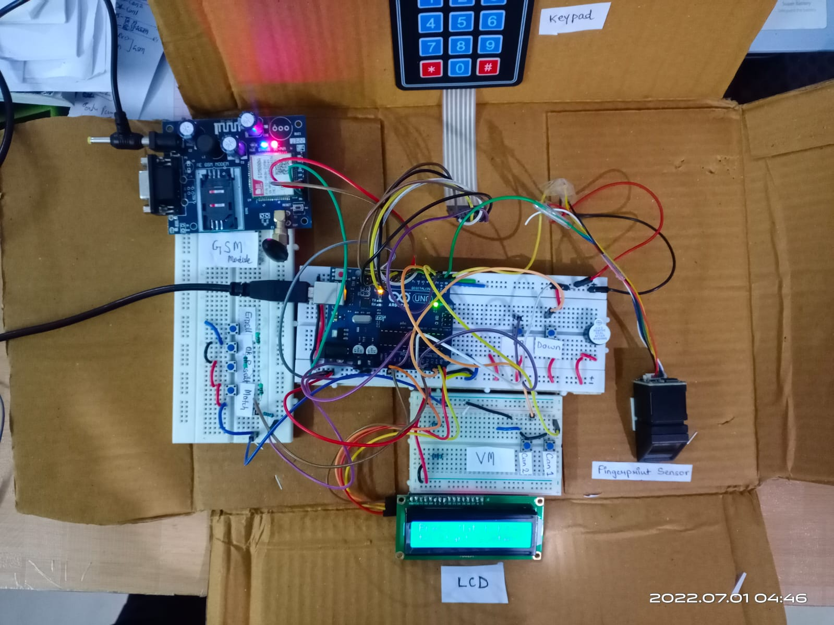
Circuit Diagram

Slide 14
Hardware and Software Tools:
Hardware used:
Microcontroller: Arduino Uno
Fingerprint Module (R307)
16x2 LCD Display (WH1602B1)
GSM Module
LEDs
Push Buttons
On/Off Switch
Piezo Speaker/Buzzer (KPX-G1203UB)
Wires and 9V Batteries
Resistors (220Ω: pull down, 1kΩ: pull up)
Software used:
IDE/Toolchain: Arduino IDE
Programming Language: Embedded C
Circuit Diagram Creator: TinkerCAD

Slide 15
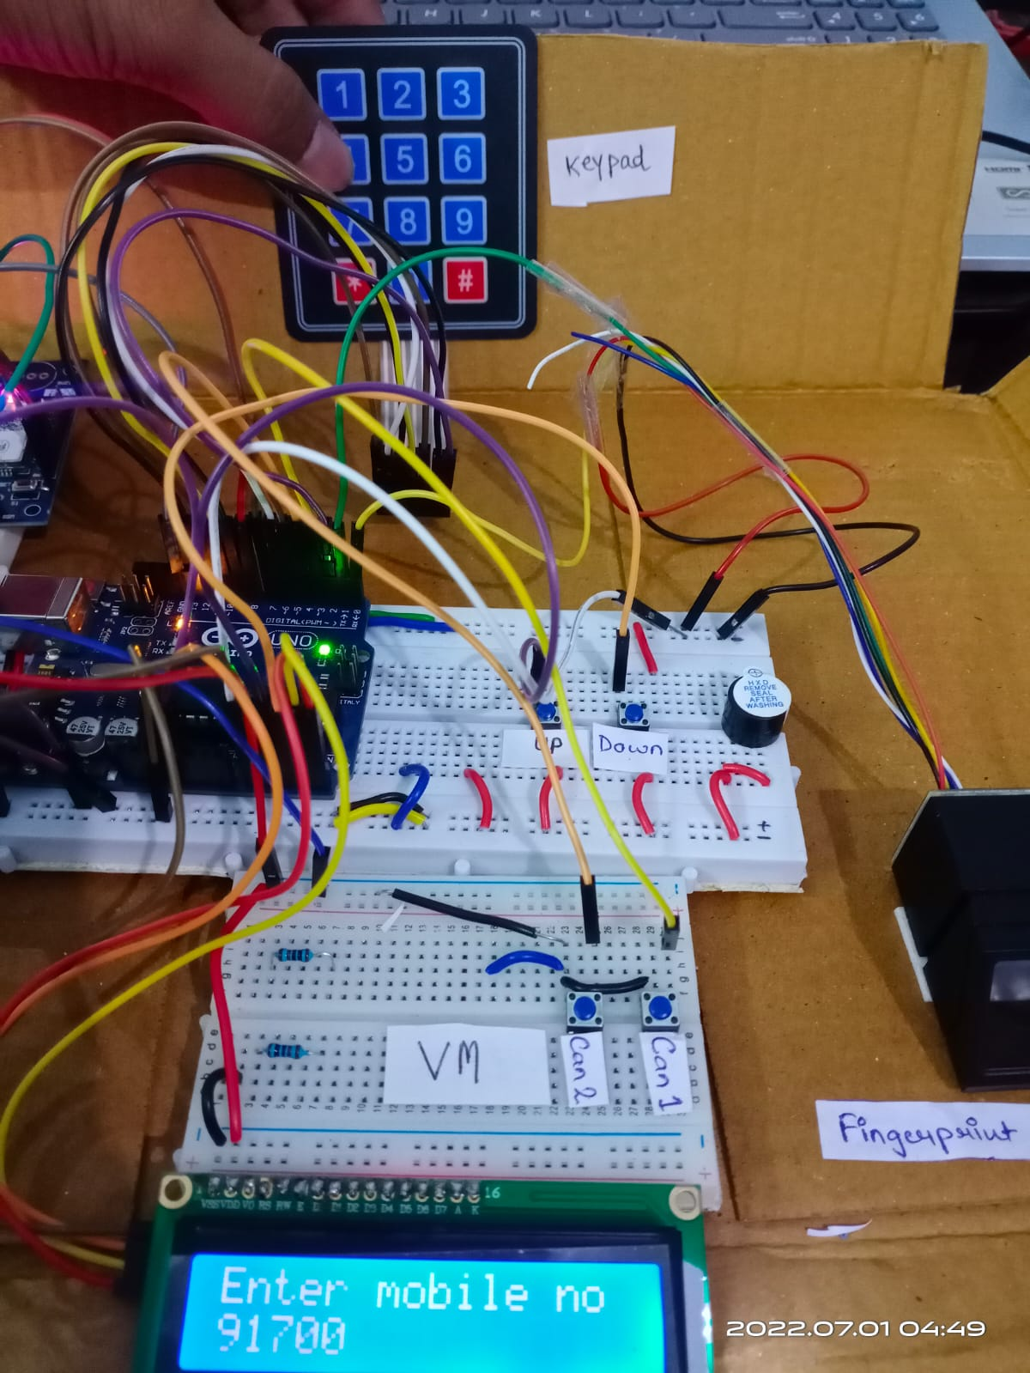
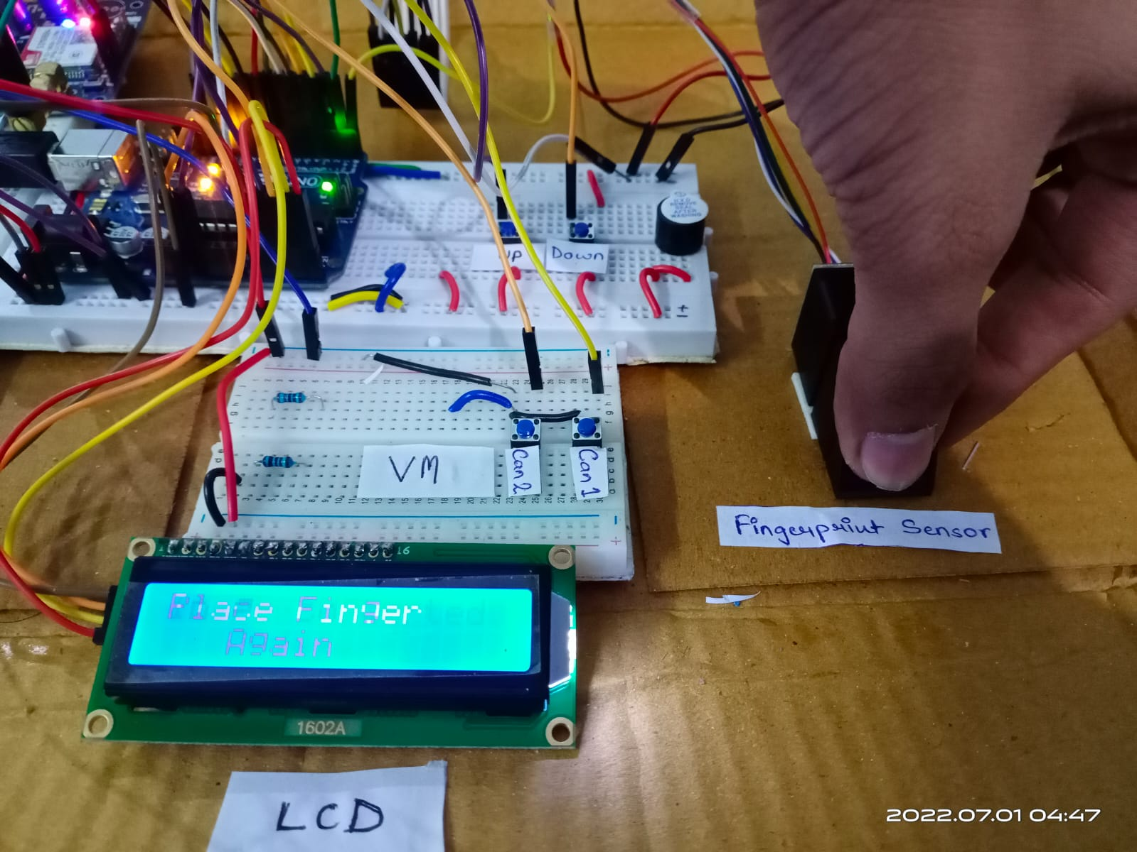
Results
Figure, (a).Enrolment of the user by recording the data base of fingerprints with IDs. (b). Registering mobile number using the keypad for the database.

Slide 16
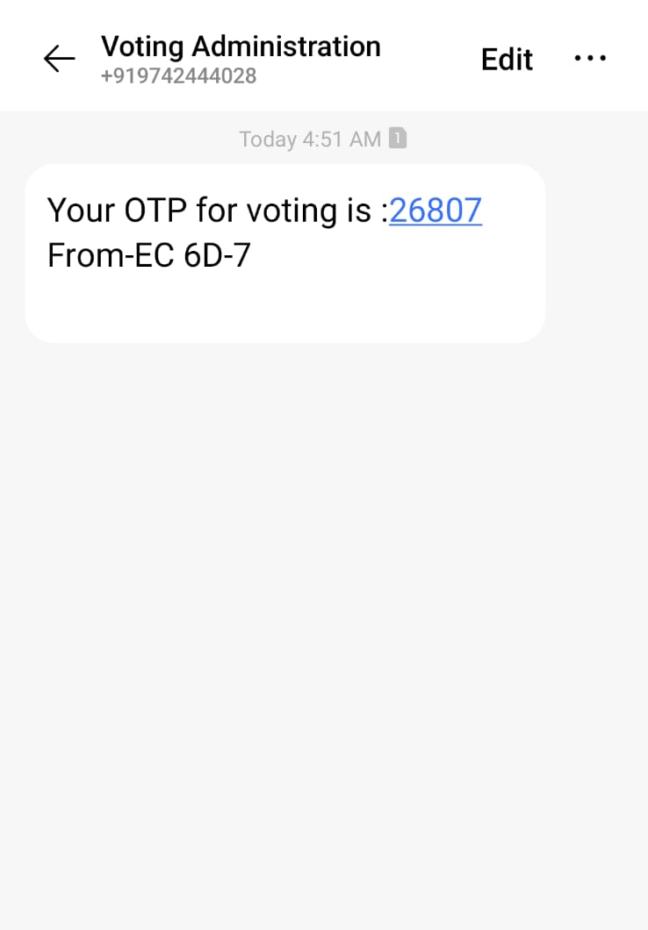
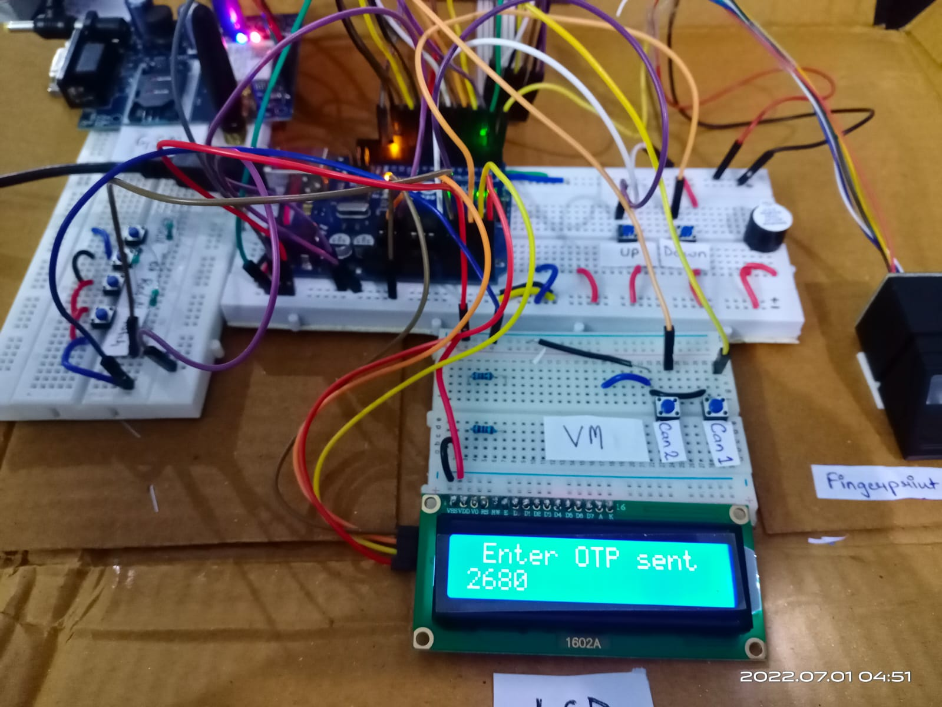
Results
Figure, (a). The OTP is required to be entered to cast the vote. (b) The OTP is received through the message on the Registered Mobile Number.

Slide 17
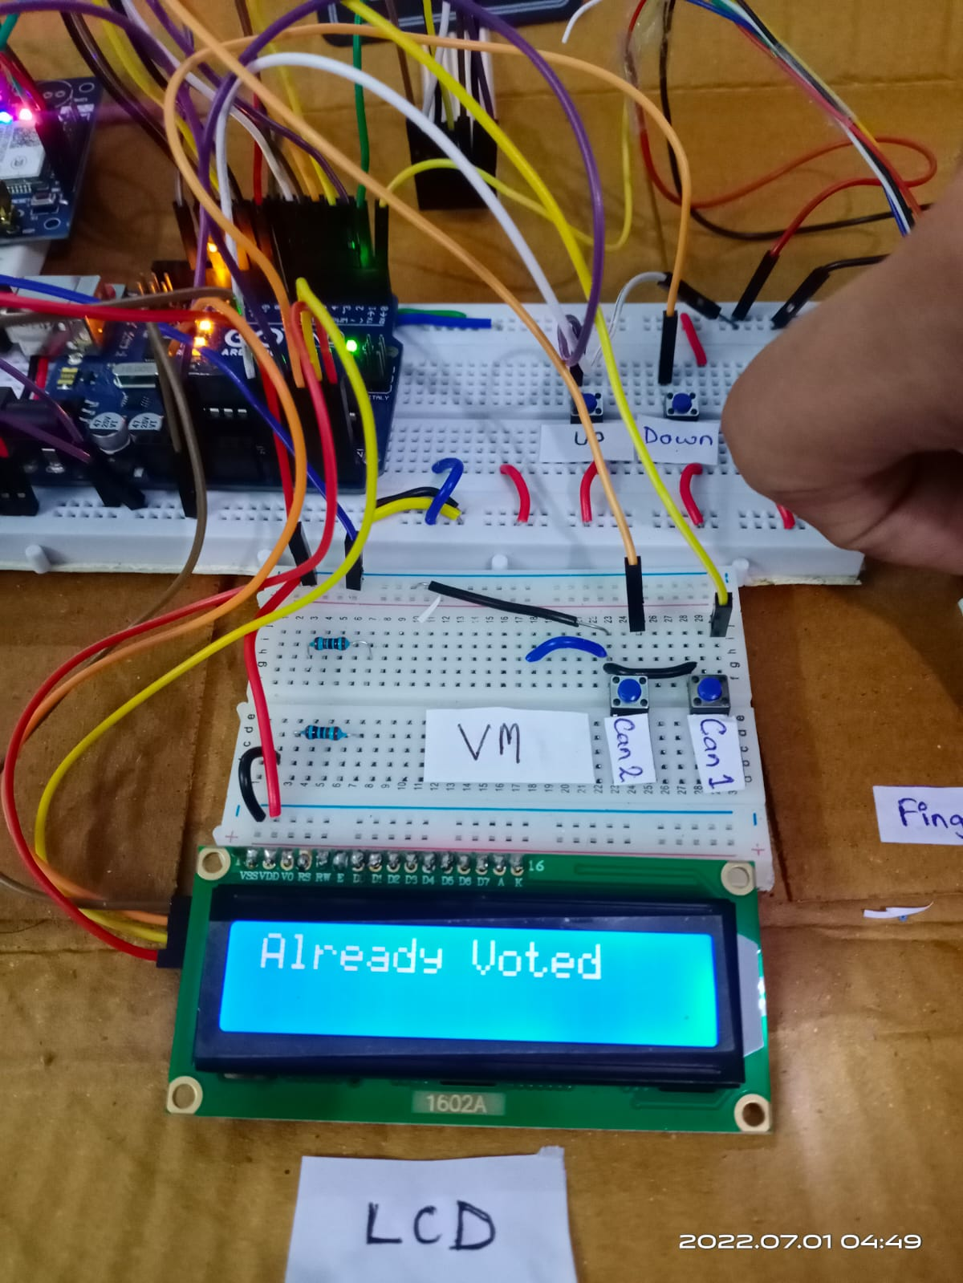
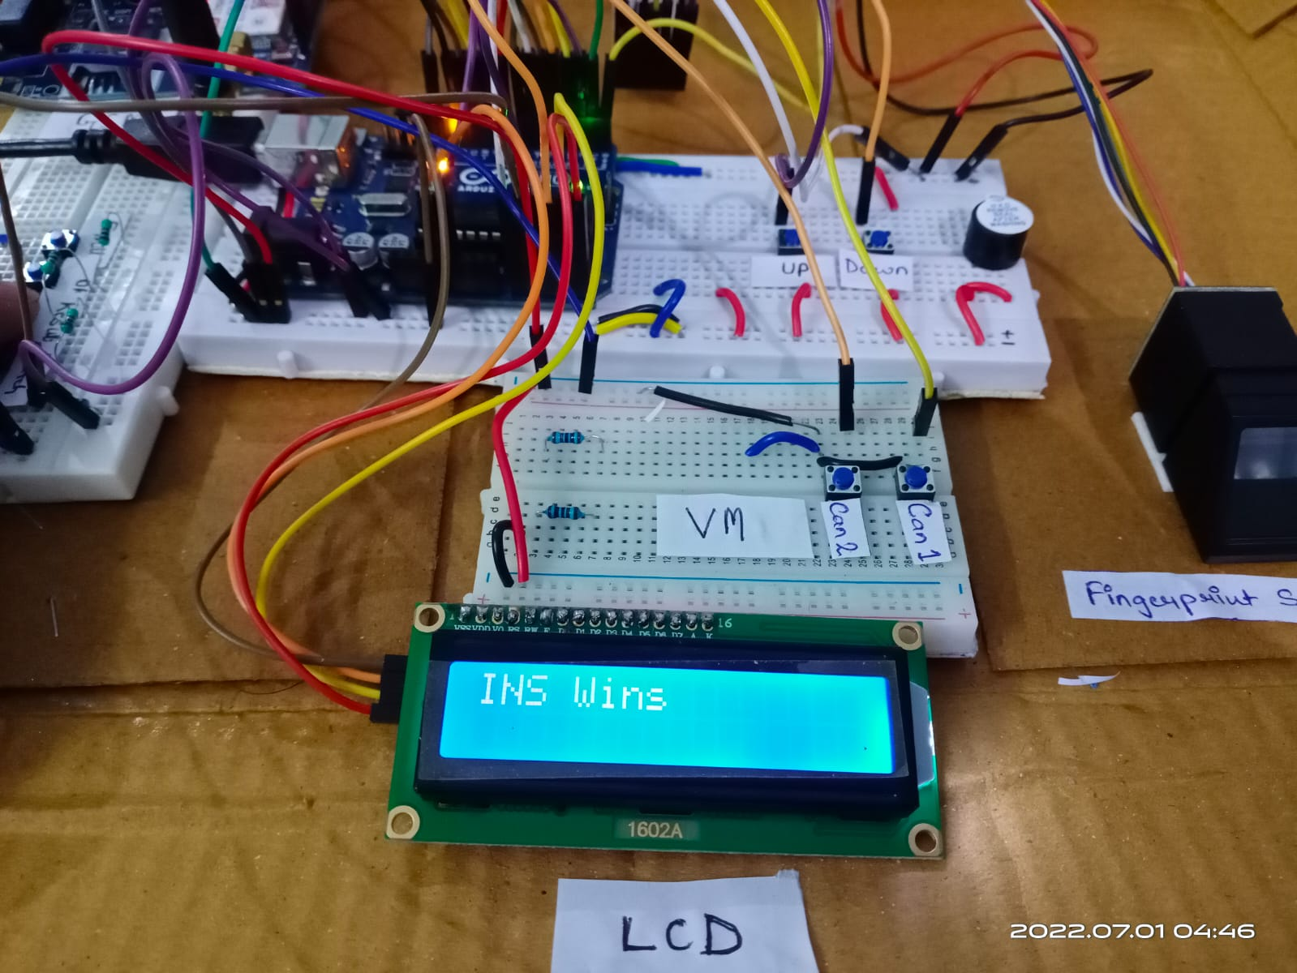
Results
Figure, (a). The results are declared if the voting procedure was successfully completed. (b) The output in case the same user tries to vote more than once.

Slide 18
Applications
The applications of the Finger-print based Voting System are not limited to a specific field and can be used in multiple arrangements and scenarios:
The biometric voting system can be used for conducting safe and secure elections in business organisations, schools and offices, etc.
It can be used to conduct all regional and ‘panchayat’ elections within a village or ‘taluka’.
Fast track voting which could be used in small scale elections, like resident welfare association and other society level elections, where results are required to be instantaneously announced.
It could also be used to conduct opinion polls during annual shareholders meeting.
It could also be used to conduct general assembly elections where number of candidates are less, on a small scale basis.

Slide 19
Advantages
Secure: This voting system ensures security as it provides two-step verification by using biometric at first level and then verification by sending OTP to the user and verifying the OTP.
Accurate: The voting system ensures accuracy by ensuring that no miscounting takes place
Quick: The turnover time per voter is reduced per voter is reduced to a considerable extent.
Simple: There are lesser and simpler steps that are required in the process rather than complex structures pre available for such electronic voting.
Less Manpower: The manpower and resources required to conduct the elections reduce to considerable extent.
Counting Time Reduction: The counting time reduces to a considerable extent, as the machine counts the votes faster than in paper ballot system.
Ease of Transportation: The system is small and mobile enough to reduce the commute hassle.

Slide 20
Outcome
The proposed system was able to meet the expected outcomes:
Recording and Creating a Database(Enrolment): The database was created consisting of Fingerprints and mobile numbers of the populous along with their respective ID.
Two – Factor Authentication: During the voting procedure, the fingerprints were successfully verified. Thereafter, for two-factor authentication, an OTP was sent to the voter’s Registered Mobile Number. On successful verification of OTP, the voter was allowed to cast their vote.
Successful Polling Action: After casting of the vote, the user was denied access to voting system, in case he/she attempts to recast the vote.
Successful Result Generation: After successful completion of the voting procedure, the result was computed and successfully displayed on the LCD screen.
The system was able to meet it’s desired outcomes!

Slide 21
Limitations
Each fingerprint voting system depends on an important external factor which is the fingerprint’s image. The resolution and the quality of the image have huge impact to the system. This system is working perfect with low quality image but it doesn’t work well with very low quality image. Very low quality image leads to rejecting the image or to false rejection.
The enrollment procedure is a tedious task that needs to be complemented manually.
The sensitivity of finger-print module causes a combination of character error.
Database Images have a large size as it has resolution of eight bits per pixel. Uploading a large number of fingerprints image to the database demands a large memory unit.
The development microcontroller boards used for developing a prototype like Arduino UNO and Nano are not suffice to manage and handle larger memory units(EEPROMs).

Slide 22
Conclusion
For over a century, fingerprints have been one of the most highly used methods for human recognition; automated biometric systems have only been available in recent years.
This work is successfully implemented and evaluated. The arrived results were significant and more comparable. It proves the fact that the fingerprint image enhancement step will certainly improve the verification performance of the fingerprint based recognition system.
Because fingerprints have a generally broad acceptance with the general public, law enforcement and the forensic science community, they will continue to be used with many governments legacy systems and will be utilized in new systems for evolving applications that require a reliable biometric.
This biometric voting system would enable hosting of fair elections in India.
This will preclude the illegal practices like rigging. The citizens can be sure that they alone can choose their leaders, thus exercising their right in the democracy.

Slide 23
Future Work
The memory of finger print module can be expanded. We can use a 1mb flash memory finger print module for increasing the capacity.
External memory(EEPROMS) of bigger size can be provided for storing the finger print image, which can be later accessed for comparison.
Smart Card reader module is supposed to be introduced with the existing module for further security, and to reduce the database storage. The smart cards may increase the n-factor authentication and also may substitute the OTP process.
Audio output in multiple languages can be introduced to make the voting or polling procedure more user friendly for illiterate voters.
Retinal scanning can also be developed which will make the system more secure and robust.
The enrollment process can be completed using an already developed identification database like AADHAR, PAN, etc. which will reduce the tediousness of the polling

Slide 24
Reflections
We learnt to implement the idea of biometric and OTP Security feature for a fair and clear voting. We applied the concept of fingerprint verification using Digital Signal Processing.
We learned to use Arduino IDE, C language programming concepts for interfacing different hardware with user.
We have learnt the concept of embedded system peripherals, Arduino programming, we are looking to forward to work more in this domain and contribute to the society.
We learnt to program and use the application of GSM, Fingerprint modules with Arduino interfacing each other with help of C language programming.
We worked as team and maintained the discipline required to complete this project.
We learned how to design documents like Reports, Circuit diagram and make effective presentations, and give and receive clear instructions.
This project provided with numerous learning opportunities and we look forward to implement our learnings in our future projects endeavors.

Slide 25
References
Ashok Kumar D., Ummal Sariba Begum T., “A Novel design of Electronic Voting System Using Fingerprint”, International Journal of Innovative Technology & Creative Engineering (ISSN:2045-8711),Vol.1,No.1. pp: 12 19, January 2011.
California Internet Voting Task Force. “A Report on the Feasibility of Internet Voting”, Jan.2000.
D. Balzarotti, G. Banks, M. Cova, V. Felmetsger, R. A Kemmerer, W. Robertson, F. Valeur, and G. Vigna, “An Experience in Testing the Security of Real-World Electronic Voting Systems,” IEEE Transactions on Software Engineering, vol. 36, no. 4, 2010.
R. Hite, “All Levels of Government are needed to Address Electronic Voting System Challenges,” Technical report, GAO, 2007.
Mobile Based Facial Recognition Using OTP Verification for Voting System 978-1-4799-8047-5/15/$31.00c 2015 IEEE.
E-Voting System with Physical Verification Using OTP Algorithm, 2015 International Journal of Hybrid Information Technology Vol.8, No.8 (2015), pp.161-166.
R. Alaguvel G. Gnanavel "Offline and Online E-Voting System with Embedded Security for Real Time" International Journal of Engineering Research (ISSN: 2319-6890) vol. 2 no. 2 pp. 76-82 April 2013

Slide 26


